Slide 1
cs5460/6460: Operating Systems Lecture: Creating Processes (exec())
Anton Burtsev
April 2024

Slide 2
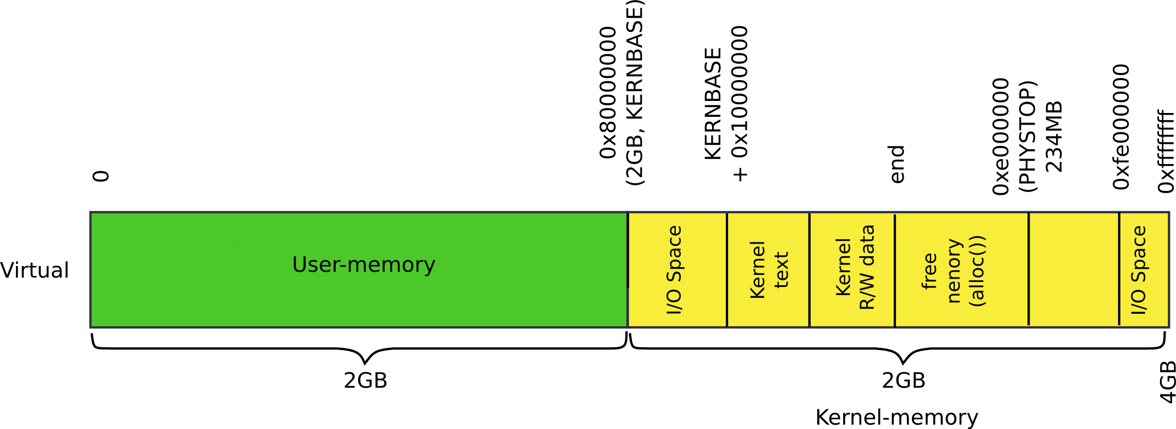
Recap: kernel memory

Slide 3
Recap: kernel memory

Slide 4
1317 main(void)
1318 {
1319 kinit1(end, P2V(4*1024*1024)); // phys page allocator
1320 kvmalloc(); // kernel page table
1321 mpinit(); // detect other processors
1322 lapicinit(); // interrupt controller
1323 seginit(); // segment descriptors
1324 cprintf("\ncpu%d: starting xv6\n\n", cpunum());
1325 picinit(); // another interrupt controller
1326 ioapicinit(); // another interrupt controller
1327 consoleinit(); // console hardware
1328 uartinit(); // serial port
1329 pinit(); // process table
1330 tvinit(); // trap vectors
1331 binit(); // buffer cache
1332 fileinit(); // file table
1333 ideinit(); // disk
1334 if(!ismp)
1335 timerinit(); // uniprocessor timer
1336 startothers(); // start other processors
1337 kinit2(P2V(4*1024*1024), P2V(PHYSTOP)); // must come after startothers()
1338 userinit(); // first user process
1339 mpmain(); // finish this processor’s setup
1340 }
main()

Slide 5
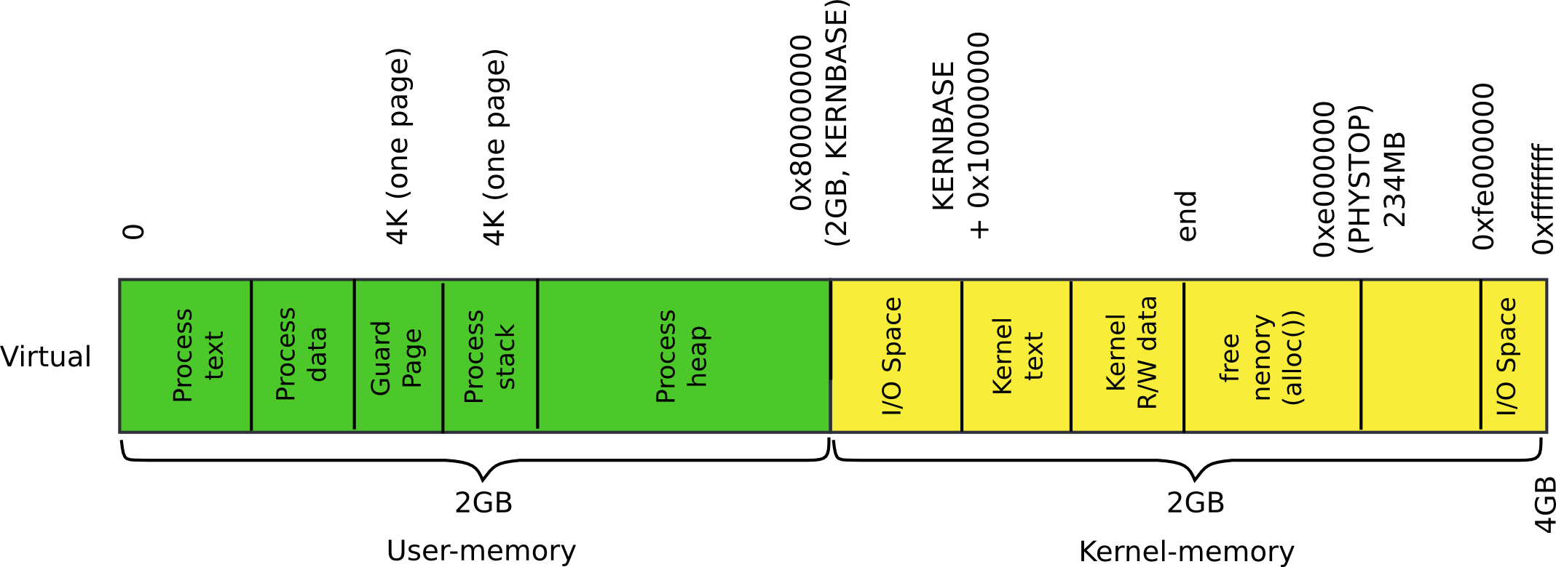
Today: process memory

Slide 6
Today: process memory

Slide 7
How does kernel creates new processes?

Slide 8
How does kernel creates new processes?
Exec
exec(“/bin/ls”, argv);

Slide 9
exec(): high-level outline
We want to create the following memory layout for the process
What shall we do?

Slide 10
exec(): high-level outline
Load program from disk
Create user-stack
Run!

Slide 11
exec(): high-level overview
Read process binary from disk
Locate a file that contains process binary
namei() takes a file path (“/bin/ls”) as an argument
Returns an inode
Read the file block by block
readi() reads the inode (file data) into memory
To read file in memory we need to construct the process address space
A page table specifically for the process

Slide 12
exec(): locate inode
6309 int
6310 exec(char *path, char **argv)
6311 {
...
6321 if((ip = namei(path)) == 0){
6322 end_op();
6323 return −1;
6324 }
6328 // Check ELF header
6329 if(readi(ip, (char*)&elf, 0, sizeof(elf)) <
sizeof(elf))
6330 goto bad;
6331 if(elf.magic != ELF_MAGIC)
6332 goto bad;

Slide 13
exec(): check ELF header
6309 int
6310 exec(char *path, char **argv)
6311 {
...
6321 if((ip = namei(path)) == 0){
6322 end_op();
6323 return −1;
6324 }
6328 // Check ELF header
6329 if(readi(ip, (char*)&elf, 0, sizeof(elf)) <
sizeof(elf))
6330 goto bad;
6331 if(elf.magic != ELF_MAGIC)
6332 goto bad;

Slide 14
Create process address space

Slide 15
exec(): Construct process address space
Two step process
Create the kernel part of the address space
Create the user part of the address space

Slide 16
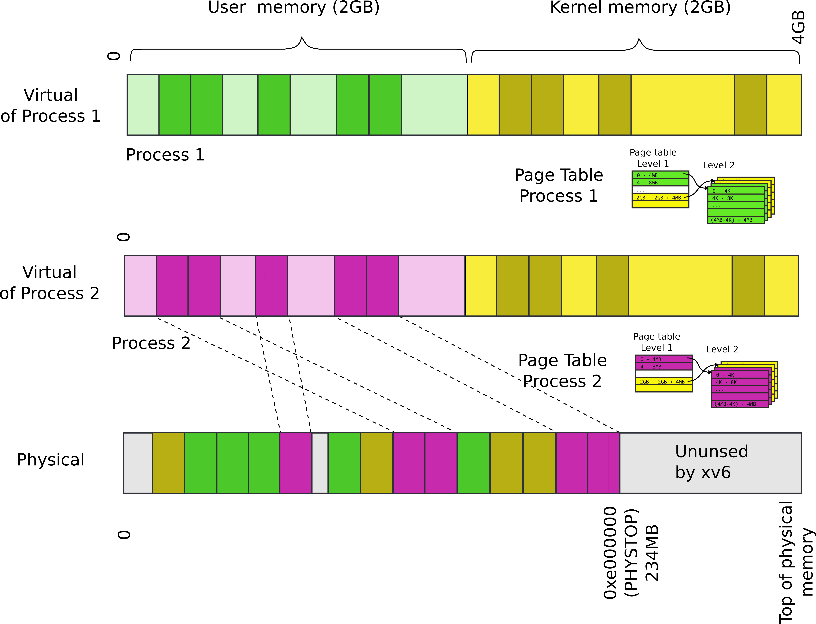
Remember: each process maps kernel in its page table

Slide 17
exec(): Setup kernel address space()
6310 exec(char *path, char **argv)
6311 {
...
6331 if(elf.magic != ELF_MAGIC)
6332 goto bad;
6334 if((pgdir = setupkvm()) == 0)
6335 goto bad;
...
Remember from the kernel memory allocator lecture?

Slide 18
Recap: Allocate page table directory
1836 pde_t*
1837 setupkvm(void)
1838 {
1839 pde_t *pgdir;
1840 struct kmap *k;
1841
1842 if((pgdir = (pde_t*)kalloc()) == 0)
1843 return 0;
1844 memset(pgdir, 0, PGSIZE);
...
1847 for(k = kmap; k < &kmap[NELEM(kmap)]; k++)
1848 if(mappages(pgdir, k−>virt, k−>phys_end − k−>phys_start,
1849 (uint)k−>phys_start, k−>perm) < 0)
1850 return 0;
1851 return pgdir;
1852 }
main()
kvmalloc()
setupkvm()

Slide 19
Recap: Iterate in a loop: remap physical pages
1836 pde_t*
1887 setupkvm(void)
1838 {
1839 pde_t *pgdir;
1840 struct kmap *k;
1841
1842 if((pgdir = (pde_t*)kalloc()) == 0)
1843 return 0;
1844 memset(pgdir, 0, PGSIZE);
...
1847 for(k = kmap; k < &kmap[NELEM(kmap)]; k++)
1848 if(mappages(pgdir, k−>virt, k−>phys_end − k−>phys_start,
1849 (uint)k−>phys_start, k−>perm) < 0)
1850 return 0;
1851 return pgdir;
1852 }
main()
kvmalloc()
setupkvm()

Slide 20
Recap: Iterate in a loop: remap physical pages
1836 pde_t*
1887 setupkvm(void)
1838 {
1839 pde_t *pgdir;
1840 struct kmap *k;
1841
1842 if((pgdir = (pde_t*)kalloc()) == 0)
1843 return 0;
1844 memset(pgdir, 0, PGSIZE);
...
1847 for(k = kmap; k < &kmap[NELEM(kmap)]; k++)
1848 if(mappages(pgdir, k−>virt, k−>phys_end − k−>phys_start,
1849 (uint)k−>phys_start, k−>perm) < 0)
1850 return 0;
1851 return pgdir;
1852 }
main()
kvmalloc()
setupkvm()

Slide 21
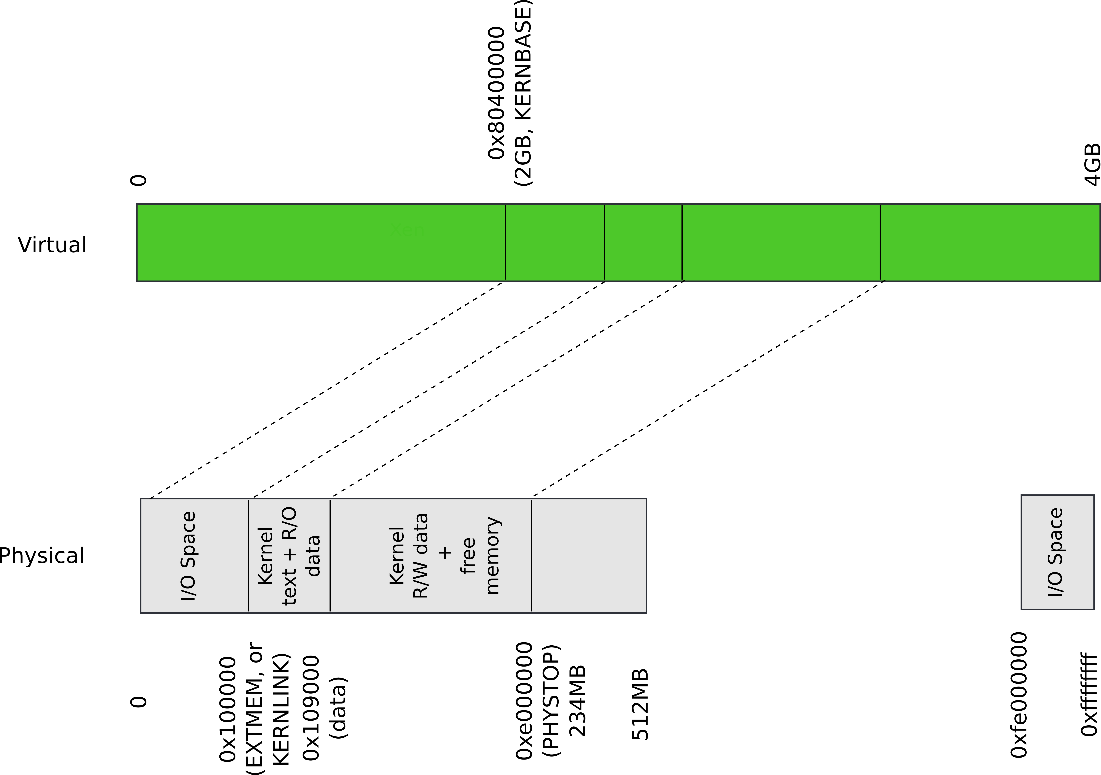
Recap: Kernel map

Slide 22
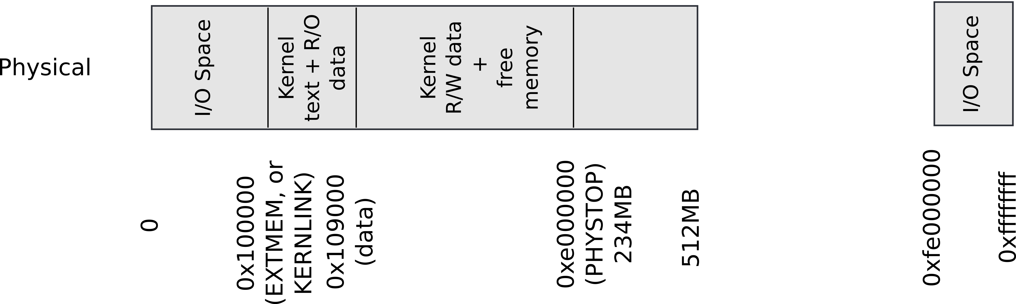
Recap: Kmap – kernel map
1823 static struct kmap {
1824 void *virt;
1825 uint phys_start;
1826 uint phys_end;
1827 int perm;
1828 } kmap[] = {
1829 { (void*)KERNBASE, 0, EXTMEM, PTE_W}, // I/O space
1830 { (void*)KERNLINK, V2P(KERNLINK), V2P(data), 0},//text+rodata
1831 { (void*)data, V2P(data), PHYSTOP, PTE_W}, // kern data+memory
1832 { (void*)DEVSPACE, DEVSPACE, 0, PTE_W}, // more devices
1833 };

Slide 23
Recap: Iterate in a loop: remap physical pages
1836 pde_t*
1887 setupkvm(void)
1838 {
1839 pde_t *pgdir;
1840 struct kmap *k;
1841
1842 if((pgdir = (pde_t*)kalloc()) == 0)
1843 return 0;
1844 memset(pgdir, 0, PGSIZE);
...
1847 for(k = kmap; k < &kmap[NELEM(kmap)]; k++)
1848 if(mappages(pgdir, k−>virt, k−>phys_end − k−>phys_start,
1849 (uint)k−>phys_start, k−>perm) < 0)
1850 return 0;
1851 return pgdir;
1852 }
main()
kvmalloc()
setupkvm()

Slide 24
exec(): Construct process address space
Two step process
Create the kernel part of the address space
Create the user part of the address space

Slide 25
Create user part of the address space

Slide 26
exec(): create user part of the address space
The goal is to fill in the page table entries
This can be naturally combined with loading the program from disk into memory
At a high level iterate in a loop
On each step:
Allocate user-level pages for the program
Map them by filling in the page table entries
Read data from the inode into that memory

Slide 27
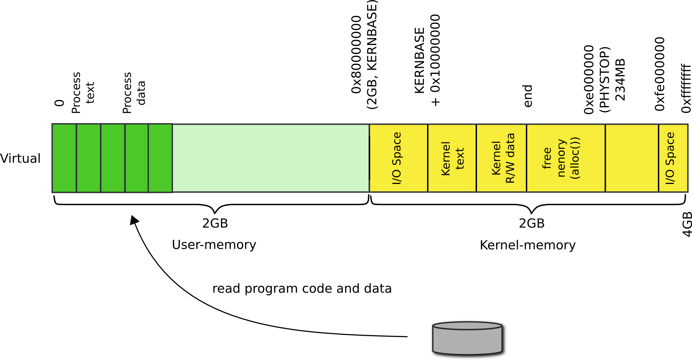
High-level idea

Slide 28
Program loading loop
6310 exec(char *path, char **argv)
6311 {
...
6337 // Load program into memory.
6338 sz = 0;
6339 for(i=0, off=elf.phoff; i<elf.phnum; i++, off+=sizeof(ph)){
6340 if(readi(ip, (char*)&ph, off, sizeof(ph)) != sizeof(ph))
6341 goto bad;
...
6348 if((sz = allocuvm(pgdir, sz, ph.vaddr + ph.memsz)) == 0)
6349 goto bad;
6350 if(ph.vaddr % PGSIZE != 0)
6351 goto bad;
6352 if(loaduvm(pgdir, (char*)ph.vaddr, ip, ph.off, ph.filesz) < 0)
6353 goto bad;
6354 }
Loop over all program headers

Slide 29
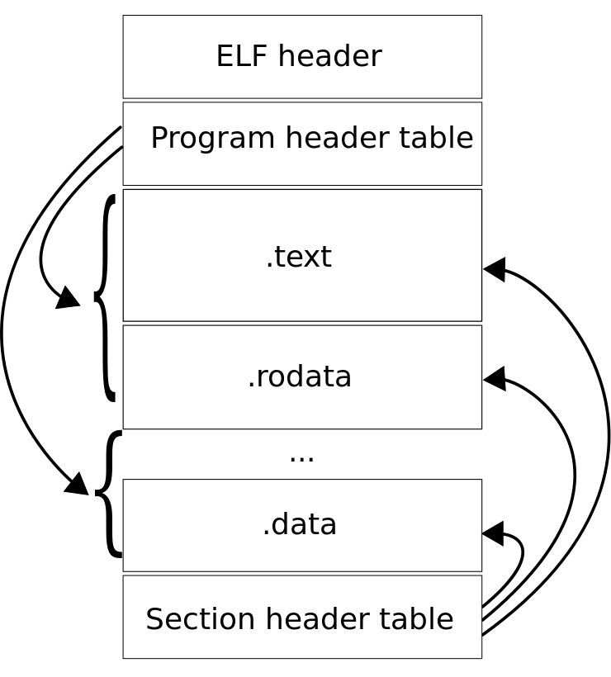
ELF object file
ELF header
Program header table
Each entry describes a section of a program
Instruction, data

Slide 30
ELF object file
ELF header
Program header table
Each entry describes a section of a program
Instruction, data

Slide 31
Program loading loop
6337 // Load program into memory.
6338 sz = 0;
6339 for(i=0, off=elf.phoff; i<elf.phnum; i++, off+=sizeof(ph)){
6340 if(readi(ip, (char*)&ph, off, sizeof(ph)) != sizeof(ph))
6341 goto bad;
...
6348 if((sz = allocuvm(pgdir, sz, ph.vaddr + ph.memsz)) == 0)
6349 goto bad;
6350 if(ph.vaddr % PGSIZE != 0)
6351 goto bad;
6352 if(loaduvm(pgdir, (char*)ph.vaddr, ip, ph.off, ph.filesz) < 0)
6353 goto bad;
6354 }
Start at the beginning of the program header table
off = elf.phoff

Slide 32
Program loading loop
6337 // Load program into memory.
6338 sz = 0;
6339 for(i=0, off=elf.phoff; i<elf.phnum; i++, off+=sizeof(ph)){
6340 if(readi(ip, (char*)&ph, off, sizeof(ph)) != sizeof(ph))
6341 goto bad;
...
6348 if((sz = allocuvm(pgdir, sz, ph.vaddr + ph.memsz)) == 0)
6349 goto bad;
6350 if(ph.vaddr % PGSIZE != 0)
6351 goto bad;
6352 if(loaduvm(pgdir, (char*)ph.vaddr, ip, ph.off, ph.filesz) < 0)
6353 goto bad;
6354 }
Read one program header entry at a time

Slide 33
Program loading loop
6337 // Load program into memory.
6338 sz = 0;
6339 for(i=0, off=elf.phoff; i<elf.phnum; i++, off+=sizeof(ph)){
6340 if(readi(ip, (char*)&ph, off, sizeof(ph)) != sizeof(ph))
6341 goto bad;
...
6348 if((sz = allocuvm(pgdir, sz, ph.vaddr + ph.memsz)) == 0)
6349 goto bad;
6350 if(ph.vaddr % PGSIZE != 0)
6351 goto bad;
6352 if(loaduvm(pgdir, (char*)ph.vaddr, ip, ph.off, ph.filesz) < 0)
6353 goto bad;
6354 }
Read one program header entry at a time
Each time increment offset by the size of the program header entry

Slide 34
Program loading loop
6337 // Load program into memory.
6338 sz = 0;
6339 for(i=0, off=elf.phoff; i<elf.phnum; i++, off+=sizeof(ph)){
6340 if(readi(ip, (char*)&ph, off, sizeof(ph)) != sizeof(ph))
6341 goto bad;
...
6348 if((sz = allocuvm(pgdir, sz, ph.vaddr + ph.memsz)) == 0)
6349 goto bad;
6350 if(ph.vaddr % PGSIZE != 0)
6351 goto bad;
6352 if(loaduvm(pgdir, (char*)ph.vaddr, ip, ph.off, ph.filesz) < 0)
6353 goto bad;
6354 }
Allocate pages for text, data, etc.

Slide 35
Program loading loop
6337 // Load program into memory.
6338 sz = 0;
6339 for(i=0, off=elf.phoff; i<elf.phnum; i++, off+=sizeof(ph)){
6340 if(readi(ip, (char*)&ph, off, sizeof(ph)) != sizeof(ph))
6341 goto bad;
...
6348 if((sz = allocuvm(pgdir, sz, ph.vaddr + ph.memsz)) == 0)
6349 goto bad;
6350 if(ph.vaddr % PGSIZE != 0)
6351 goto bad;
6352 if(loaduvm(pgdir, (char*)ph.vaddr, ip, ph.off, ph.filesz) < 0)
6353 goto bad;
6354 }
sz is the size of the address space
Initially it’s 0

Slide 36
Program loading loop
6337 // Load program into memory.
6338 sz = 0;
6339 for(i=0, off=elf.phoff; i<elf.phnum; i++, off+=sizeof(ph)){
6340 if(readi(ip, (char*)&ph, off, sizeof(ph)) != sizeof(ph))
6341 goto bad;
...
6348 if((sz = allocuvm(pgdir, sz, ph.vaddr + ph.memsz)) == 0)
6349 goto bad;
6350 if(ph.vaddr % PGSIZE != 0)
6351 goto bad;
6352 if(loaduvm(pgdir, (char*)ph.vaddr, ip, ph.off, ph.filesz) < 0)
6353 goto bad;
6354 }
New size of the address space

Slide 37
Program loading loop
6337 // Load program into memory.
6338 sz = 0;
6339 for(i=0, off=elf.phoff; i<elf.phnum; i++, off+=sizeof(ph)){
6340 if(readi(ip, (char*)&ph, off, sizeof(ph)) != sizeof(ph))
6341 goto bad;
...
6348 if((sz = allocuvm(pgdir, sz, ph.vaddr + ph.memsz)) == 0)
6349 goto bad;
6350 if(ph.vaddr % PGSIZE != 0)
6351 goto bad;
6352 if(loaduvm(pgdir, (char*)ph.vaddr, ip, ph.off, ph.filesz) < 0)
6353 goto bad;
6354 }
Load program section from disk

Slide 38
Two main functions
allocuvm() -- allocate and map user-memory
loaduvm() -- load user-memory with data from disk

Slide 39
Lets take a closer look
allocuvm()

Slide 40
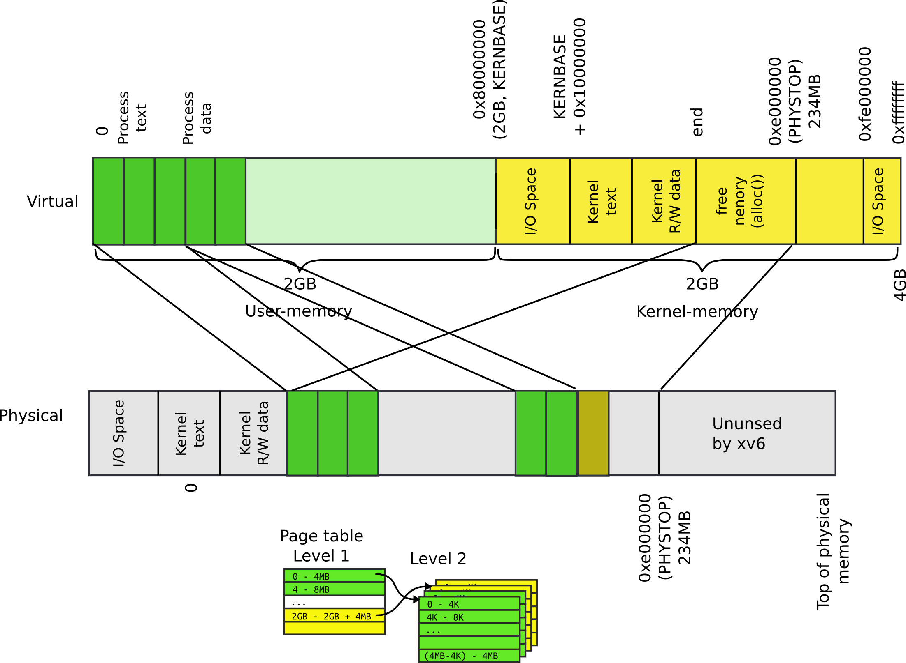
allocuvm(): allocate user pages

Slide 41
Allocate user address space
1953 allocuvm(pde_t *pgdir, uint oldsz, uint newsz)
1954 {
...
1958 if(newsz >= KERNBASE)
1959 return 0;
…
1963 a = PGROUNDUP(oldsz);
1964 for(; a < newsz; a += PGSIZE){
1965 mem = kalloc();
...
1971 memset(mem, 0, PGSIZE);
1972 if(mappages(pgdir, (char*)a, PGSIZE, V2P(mem), PTE_W|PTE_U) < 0){
...
1976 return 0;
1977 }
1978 }
1979 return newsz;
1980 }
New size can't be over 2GB

Slide 42
Allocate user address space
1953 allocuvm(pde_t *pgdir, uint oldsz, uint newsz)
1954 {
...
1958 if(newsz >= KERNBASE)
1959 return 0;
…
1963 a = PGROUNDUP(oldsz);
1964 for(; a < newsz; a += PGSIZE){
1965 mem = kalloc();
...
1971 memset(mem, 0, PGSIZE);
1972 if(mappages(pgdir, (char*)a, PGSIZE, V2P(mem), PTE_W|PTE_U) < 0){
...
1976 return 0;
1977 }
1978 }
1979 return newsz;
1980 }
Start with the old size rounded up to the next page

Slide 43
Allocate user address space
1953 allocuvm(pde_t *pgdir, uint oldsz, uint newsz)
1954 {
...
1958 if(newsz >= KERNBASE)
1959 return 0;
…
1963 a = PGROUNDUP(oldsz);
1964 for(; a < newsz; a += PGSIZE){
1965 mem = kalloc();
...
1971 memset(mem, 0, PGSIZE);
1972 if(mappages(pgdir, (char*)a, PGSIZE, V2P(mem), PTE_W|PTE_U) < 0){
...
1976 return 0;
1977 }
1978 }
1979 return newsz;
1980 }
Allocate a new page

Slide 44
Allocate user address space
1953 allocuvm(pde_t *pgdir, uint oldsz, uint newsz)
1954 {
...
1958 if(newsz >= KERNBASE)
1959 return 0;
…
1963 a = PGROUNDUP(oldsz);
1964 for(; a < newsz; a += PGSIZE){
1965 mem = kalloc();
...
1971 memset(mem, 0, PGSIZE);
1972 if(mappages(pgdir, (char*)a, PGSIZE, V2P(mem), PTE_W|PTE_U) < 0){
...
1976 return 0;
1977 }
1978 }
1979 return newsz;
1980 }
Allocate a new page
Where does this memory come from?

Slide 45
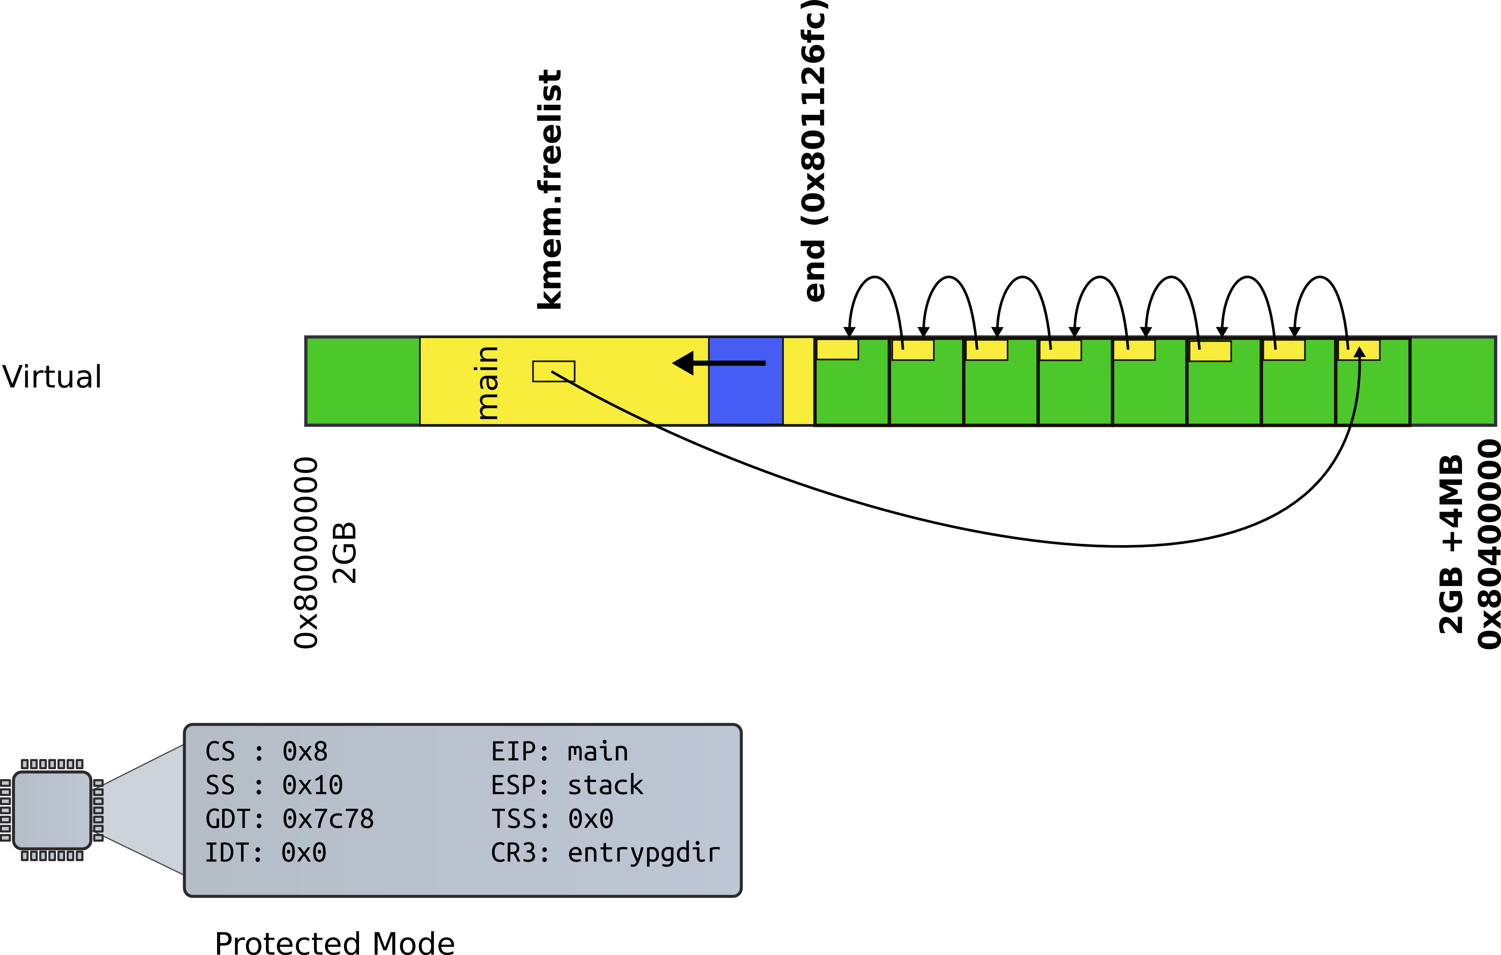
Kernel memory allocator

Slide 46
Allocate user address space
1953 allocuvm(pde_t *pgdir, uint oldsz, uint newsz)
1954 {
...
1958 if(newsz >= KERNBASE)
1959 return 0;
…
1963 a = PGROUNDUP(oldsz);
1964 for(; a < newsz; a += PGSIZE){
1965 mem = kalloc();
...
1971 memset(mem, 0, PGSIZE);
1972 if(mappages(pgdir, (char*)a, PGSIZE, V2P(mem), PTE_W|PTE_U) < 0){
...
1976 return 0;
1977 }
1978 }
1979 return newsz;
1980 }
Make sure the page is clean
Don’t leak data

Slide 47
Allocate user address space
1953 allocuvm(pde_t *pgdir, uint oldsz, uint newsz)
1954 {
...
1958 if(newsz >= KERNBASE)
1959 return 0;
…
1963 a = PGROUNDUP(oldsz);
1964 for(; a < newsz; a += PGSIZE){
1965 mem = kalloc();
...
1971 memset(mem, 0, PGSIZE);
1972 if(mappages(pgdir, (char*)a, PGSIZE, V2P(mem), PTE_W|PTE_U) < 0){
...
1976 return 0;
1977 }
1978 }
1979 return newsz;
1980 }
Map the page

Slide 48
Allocate user address space
1953 allocuvm(pde_t *pgdir, uint oldsz, uint newsz)
1954 {
...
1958 if(newsz >= KERNBASE)
1959 return 0;
…
1963 a = PGROUNDUP(oldsz);
1964 for(; a < newsz; a += PGSIZE){
1965 mem = kalloc();
...
1971 memset(mem, 0, PGSIZE);
1972 if(mappages(pgdir, (char*)a, PGSIZE, V2P(mem), PTE_W|PTE_U) < 0){
...
1976 return 0;
1977 }
1978 }
1979 return newsz;
1980 }
Take page table directory as an argument

Slide 49
Allocate user address space
1953 allocuvm(pde_t *pgdir, uint oldsz, uint newsz)
1954 {
...
1958 if(newsz >= KERNBASE)
1959 return 0;
…
1963 a = PGROUNDUP(oldsz);
1964 for(; a < newsz; a += PGSIZE){
1965 mem = kalloc();
...
1971 memset(mem, 0, PGSIZE);
1972 if(mappages(pgdir, (char*)a, PGSIZE, V2P(mem), PTE_W|PTE_U) < 0){
...
1976 return 0;
1977 }
1978 }
1979 return newsz;
1980 }
Virtual address of the page to map

Slide 50
Allocate user address space
1953 allocuvm(pde_t *pgdir, uint oldsz, uint newsz)
1954 {
...
1958 if(newsz >= KERNBASE)
1959 return 0;
…
1963 a = PGROUNDUP(oldsz);
1964 for(; a < newsz; a += PGSIZE){
1965 mem = kalloc();
...
1971 memset(mem, 0, PGSIZE);
1972 if(mappages(pgdir, (char*)a, PGSIZE, V2P(mem), PTE_W|PTE_U) < 0){
...
1976 return 0;
1977 }
1978 }
1979 return newsz;
1980 }
Size of the region
One page!

Slide 51
Allocate user address space
1953 allocuvm(pde_t *pgdir, uint oldsz, uint newsz)
1954 {
...
1958 if(newsz >= KERNBASE)
1959 return 0;
…
1963 a = PGROUNDUP(oldsz);
1964 for(; a < newsz; a += PGSIZE){
1965 mem = kalloc();
...
1971 memset(mem, 0, PGSIZE);
1972 if(mappages(pgdir, (char*)a, PGSIZE, V2P(mem), PTE_W|PTE_U) < 0){
...
1976 return 0;
1977 }
1978 }
1979 return newsz;
1980 }
Physical address of the page we’re mapping
V2P!

Slide 52
Allocate user address space
1953 allocuvm(pde_t *pgdir, uint oldsz, uint newsz)
1954 {
...
1958 if(newsz >= KERNBASE)
1959 return 0;
…
1963 a = PGROUNDUP(oldsz);
1964 for(; a < newsz; a += PGSIZE){
1965 mem = kalloc();
...
1971 memset(mem, 0, PGSIZE);
1972 if(mappages(pgdir, (char*)a, PGSIZE, V2P(mem), PTE_W|PTE_U) < 0){
...
1976 return 0;
1977 }
1978 }
1979 return newsz;
1980 }
Flags
Writable and user-accessible

Slide 53
Who remembers mappages()?
Remember we want a region of memory to be mapped
i.e., appear in the page table

Slide 54
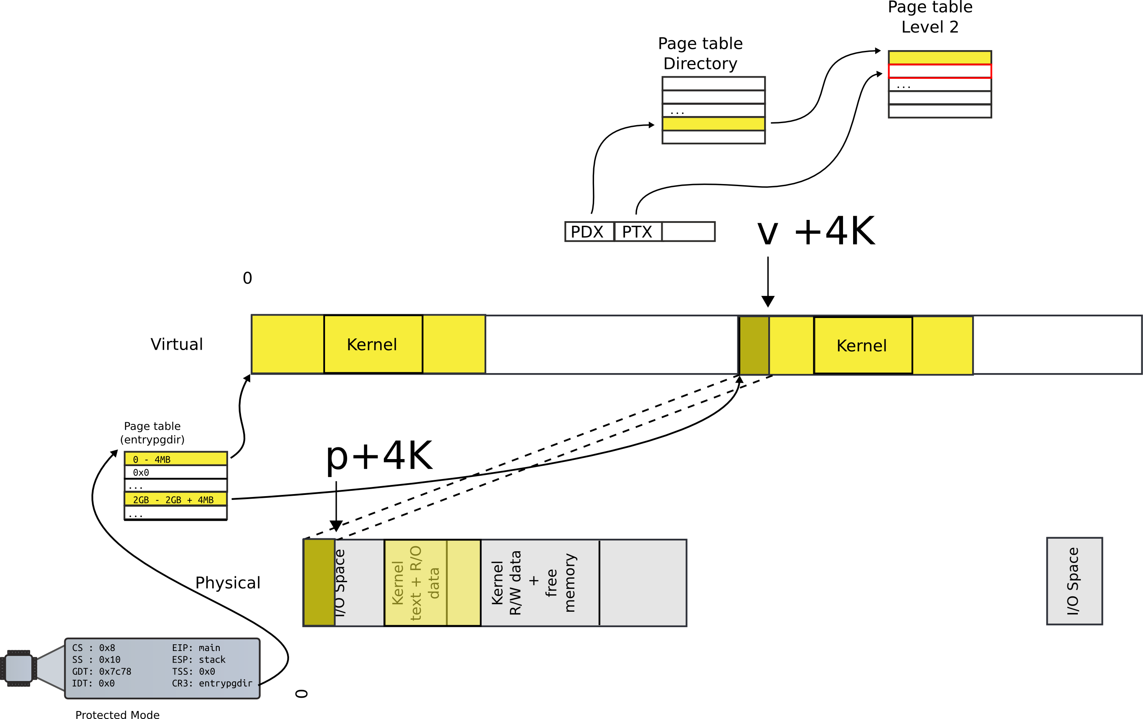
mappages(): map a region

Slide 55
Lookup the page table entry
1779 mappages(pde_t *pgdir, void *va, uint size, uint pa, int perm)
1780 {
1781 char *a, *last;
1782 pte_t *pte;
1783
1784 a = (char*)PGROUNDDOWN((uint)va);
1785 last = (char*)PGROUNDDOWN(((uint)va) + size − 1);
1786 for(;;){
1787 if((pte = walkpgdir(pgdir, a, 1)) == 0)
1788 return −1;
1789 if(*pte & PTE_P)
1790 panic("remap");
1791 *pte = pa | perm | PTE_P;
1792 if(a == last)
1793 break;
1794 a += PGSIZE;
1795 pa += PGSIZE;
1796 }
1797 return 0;
1798 }
main()
kvmalloc()
setupkvm()
mappages()

Slide 56
Walk page table
1754 walkpgdir(pde_t *pgdir, const void *va, int alloc)
1755 {
1756 pde_t *pde;
1757 pte_t *pgtab;
1758
1759 pde = &pgdir[PDX(va)];
1760 if(*pde & PTE_P){
1761 pgtab = (pte_t*)P2V(PTE_ADDR(*pde));
1762 } else {
1763 if(!alloc || (pgtab = (pte_t*)kalloc()) == 0)
1764 return 0;
1765 // Make sure all those PTE_P bits are zero.
1766 memset(pgtab, 0, PGSIZE);
...
1770 *pde = V2P(pgtab) | PTE_P | PTE_W | PTE_U;
1771 }
1772 return &pgtab[PTX(va)];
1773 }
main()
kvmalloc()
setupkvm()
mappages()
walkpagedir()

Slide 57
Allocate user address space
1953 allocuvm(pde_t *pgdir, uint oldsz, uint newsz)
1954 {
...
1958 if(newsz >= KERNBASE)
1959 return 0;
…
1963 a = PGROUNDUP(oldsz);
1964 for(; a < newsz; a += PGSIZE){
1965 mem = kalloc();
...
1971 memset(mem, 0, PGSIZE);
1972 if(mappages(pgdir, (char*)a, PGSIZE, V2P(mem), PTE_W|PTE_U) < 0){
...
1976 return 0;
1977 }
1978 }
1979 return newsz;
1980 }
Continue in a loop

Slide 58
Now the second function: loaduvm()

Slide 59
exec() – create a new process
Read process binary from disk
namei() takes a file path (“/bin/ls”) as an argument
Returns an inode
readi() reads the inode (file data)
Create process address space
Create a page table
Map only kernel space
Load program into memory
Allocate user-level pages for the program
Read data from the inode into that memory

Slide 60
Load program into memory
6337 // Load program into memory.
6338 sz = 0;
6339 for(i=0, off=elf.phoff; i<elf.phnum; i++, off+=sizeof(ph)){
6340 if(readi(ip, (char*)&ph, off, sizeof(ph)) != sizeof(ph))
6341 goto bad;
...
6348 if((sz = allocuvm(pgdir, sz, ph.vaddr + ph.memsz)) == 0)
6349 goto bad;
6350 if(ph.vaddr % PGSIZE != 0)
6351 goto bad;
6352 if(loaduvm(pgdir, (char*)ph.vaddr, ip, ph.off, ph.filesz) < 0)
6353 goto bad;
6354 }
Load program section from disk

Slide 61
loaduvm(): read program from disk

Slide 62
Load program into memory
1918 loaduvm(pde_t *pgdir, char *addr, struct inode *ip, uint offset, uint sz)
1919 {
...
1925 for(i = 0; i < sz; i += PGSIZE){
1926 if((pte = walkpgdir(pgdir, addr+i, 0)) == 0)
1927 panic("loaduvm: address should exist");
1928 pa = PTE_ADDR(*pte);
1929 if(sz − i < PGSIZE)
1930 n = sz − i;
1931 else
1932 n = PGSIZE;
1933 if(readi(ip, P2V(pa), offset+i, n) != n)
1934 return −1;
1935 }
1936 return 0;
1937 }
Locate pte
addr is virtual address where the program has to be loaded

Slide 63
Load program into memory
1918 loaduvm(pde_t *pgdir, char *addr, struct inode *ip, uint offset, uint sz)
1919 {
...
1925 for(i = 0; i < sz; i += PGSIZE){
1926 if((pte = walkpgdir(pgdir, addr+i, 0)) == 0)
1927 panic("loaduvm: address should exist");
1928 pa = PTE_ADDR(*pte);
1929 if(sz − i < PGSIZE)
1930 n = sz − i;
1931 else
1932 n = PGSIZE;
1933 if(readi(ip, P2V(pa), offset+i, n) != n)
1934 return −1;
1935 }
1936 return 0;
1937 }
Pte (page table entry) of the physical page backing up the virtual page

Slide 64
Load program into memory
1918 loaduvm(pde_t *pgdir, char *addr, struct inode *ip, uint offset, uint sz)
1919 {
...
1925 for(i = 0; i < sz; i += PGSIZE){
1926 if((pte = walkpgdir(pgdir, addr+i, 0)) == 0)
1927 panic("loaduvm: address should exist");
1928 pa = PTE_ADDR(*pte);
1929 if(sz − i < PGSIZE)
1930 n = sz − i;
1931 else
1932 n = PGSIZE;
1933 if(readi(ip, P2V(pa), offset+i, n) != n)
1934 return −1;
1935 }
1936 return 0;
1937 }
Resolve pte into physical address

Slide 65
Load program into memory
1918 loaduvm(pde_t *pgdir, char *addr, struct inode *ip, uint offset, uint sz)
1919 {
...
1925 for(i = 0; i < sz; i += PGSIZE){
1926 if((pte = walkpgdir(pgdir, addr+i, 0)) == 0)
1927 panic("loaduvm: address should exist");
1928 pa = PTE_ADDR(*pte);
1929 if(sz − i < PGSIZE)
1930 n = sz − i;
1931 else
1932 n = PGSIZE;
1933 if(readi(ip, P2V(pa), offset+i, n) != n)
1934 return −1;
1935 }
1936 return 0;
1937 }
Then use the virtual address of that physical page

Slide 66
Load program into memory
1918 loaduvm(pde_t *pgdir, char *addr, struct inode *ip, uint offset, uint sz)
1919 {
...
1925 for(i = 0; i < sz; i += PGSIZE){
1926 if((pte = walkpgdir(pgdir, addr+i, 0)) == 0)
1927 panic("loaduvm: address should exist");
1928 pa = PTE_ADDR(*pte);
1929 if(sz − i < PGSIZE)
1930 n = sz − i;
1931 else
1932 n = PGSIZE;
1933 if(readi(ip, P2V(pa), offset+i, n) != n)
1934 return −1;
1935 }
1936 return 0;
1937 }
Wait... virtual address of a page?

Slide 67
Load program into memory
1918 loaduvm(pde_t *pgdir, char *addr, struct inode *ip, uint offset, uint sz)
1919 {
...
1925 for(i = 0; i < sz; i += PGSIZE){
1926 if((pte = walkpgdir(pgdir, addr+i, 0)) == 0)
1927 panic("loaduvm: address should exist");
1928 pa = PTE_ADDR(*pte);
1929 if(sz − i < PGSIZE)
1930 n = sz − i;
1931 else
1932 n = PGSIZE;
1933 if(readi(ip, P2V(pa), offset+i, n) != n)
1934 return −1;
1935 }
1936 return 0;
1937 }
Why can't we use addr directly?

Slide 68
Drawing: two page tables

Slide 69
Load program into memory
1918 loaduvm(pde_t *pgdir, char *addr, struct inode *ip, uint offset, uint sz)
1919 {
...
1925 for(i = 0; i < sz; i += PGSIZE){
1926 if((pte = walkpgdir(pgdir, addr+i, 0)) == 0)
1927 panic("loaduvm: address should exist");
1928 pa = PTE_ADDR(*pte);
1929 if(sz − i < PGSIZE)
1930 n = sz − i;
1931 else
1932 n = PGSIZE;
1933 if(readi(ip, P2V(pa), offset+i, n) != n)
1934 return −1;
1935 }
1936 return 0;
1937 }
Read the page from disk

Slide 70
exec() – create a new process
Read process binary from disk
Create process address space
Load program into memory
Allocate program stack

Slide 71
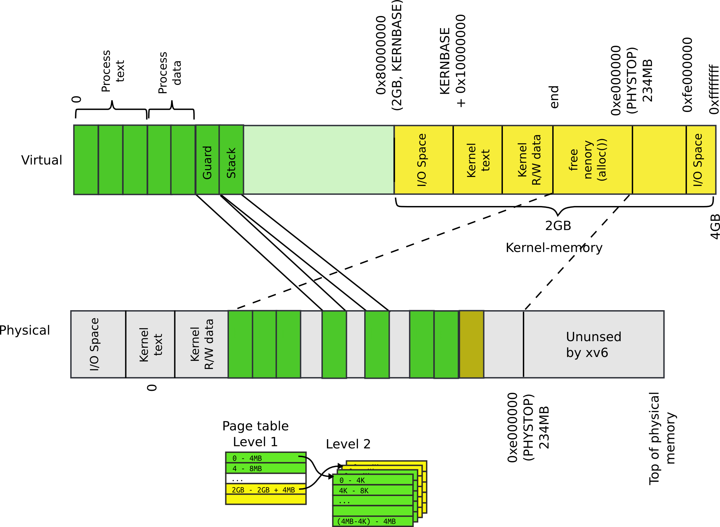
Allocate stack

Slide 72
exec(): allocate process' stack
Allocate two pages
One will be stack
Mark another one as inaccessible
6361 sz = PGROUNDUP(sz);
6362 if((sz = allocuvm(pgdir, sz, sz + 2*PGSIZE)) == 0)
6363 goto bad;
6364 clearpteu(pgdir, (char*)(sz − 2*PGSIZE));
6365 sp = sz;

Slide 73
exec() – create a new process
Read process binary from disk
Create process address space
Load program into memory
Allocate program stack
Push program arguments on the stack

Slide 74
Remember arguments to main()?
int main(int argc, char **argv);
If you run
./program hello world
Then:
argc would be 3
argv[0] would be a pointer to "./program"
argv[1] would be a pointer to "hello"
argv[2] would be a pointer to "world"

Slide 75
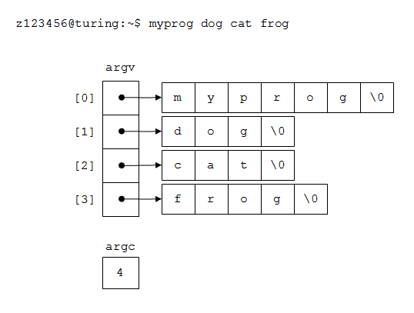
Argv and argc

Slide 76
Arguments to main() are passed on the stack
Copy argument strings at the top of the stack
One at a time
Record pointers to them in ustack
Which will be an argument list (argv list)

Slide 77
Copy elements of the array one by one on the stack
Remember we can’t use virtual addresses directly
6367 // Push argument strings, prepare rest of stack in ustack.
6368 for(argc = 0; argv[argc]; argc++) {
...
6371 sp = (sp − (strlen(argv[argc]) + 1)) & ~3;
6372 if(copyout(pgdir, sp, argv[argc], strlen(argv[argc]) + 1) < 0)
6373 goto bad;
6374 ustack[3+argc] = sp;
6375 }
6376 ustack[3+argc] = 0;
6377
6378 ustack[0] = 0xffffffff; // fake return PC
6379 ustack[1] = argc;
6380 ustack[2] = sp − (argc+1)*4; // argv pointer
6381
6382 sp −= (3+argc+1) * 4;
6383 if(copyout(pgdir, sp, ustack, (3+argc+1)*4) < 0)
6384 goto bad;

Slide 78
Push argc – number of arguments in the argv[]
6367 // Push argument strings, prepare rest of stack in ustack.
6368 for(argc = 0; argv[argc]; argc++) {
...
6371 sp = (sp − (strlen(argv[argc]) + 1)) & ~3;
6372 if(copyout(pgdir, sp, argv[argc], strlen(argv[argc]) + 1) < 0)
6373 goto bad;
6374 ustack[3+argc] = sp;
6375 }
6376 ustack[3+argc] = 0;
6377
6378 ustack[0] = 0xffffffff; // fake return PC
6379 ustack[1] = argc;
6380 ustack[2] = sp − (argc+1)*4; // argv pointer
6381
6382 sp −= (3+argc+1) * 4;
6383 if(copyout(pgdir, sp, ustack, (3+argc+1)*4) < 0)
6384 goto bad;

Slide 79
Push argv pointer – argv[] is on the stack itself
6367 // Push argument strings, prepare rest of stack in ustack.
6368 for(argc = 0; argv[argc]; argc++) {
...
6371 sp = (sp − (strlen(argv[argc]) + 1)) & ~3;
6372 if(copyout(pgdir, sp, argv[argc], strlen(argv[argc]) + 1) < 0)
6373 goto bad;
6374 ustack[3+argc] = sp;
6375 }
6376 ustack[3+argc] = 0;
6377
6378 ustack[0] = 0xffffffff; // fake return PC
6379 ustack[1] = argc;
6380 ustack[2] = sp − (argc+1)*4; // argv pointer
6381
6382 sp −= (3+argc+1) * 4;
6383 if(copyout(pgdir, sp, ustack, (3+argc+1)*4) < 0)
6384 goto bad;

Slide 80
exec() – create a new process
Read process binary from disk
Create process address space
Load program into memory
Allocate program stack
Push program arguments on the stack
Switch page tables

Slide 81
exec(): switch page tables
Switch page tables
Deallocate the old page table
6309 int
6310 exec(char *path, char **argv)
6311 {
…
6398 switchuvm(proc);
6399 freevm(oldpgdir);
6400 return 0;
...
6410

Slide 82
Wait... which page table we are deallocating?

Slide 83
Wait... which page table we are deallocating?
Remember exec() replaces content of an already existing process
That process had a page table
We have to deallocate it

Slide 84
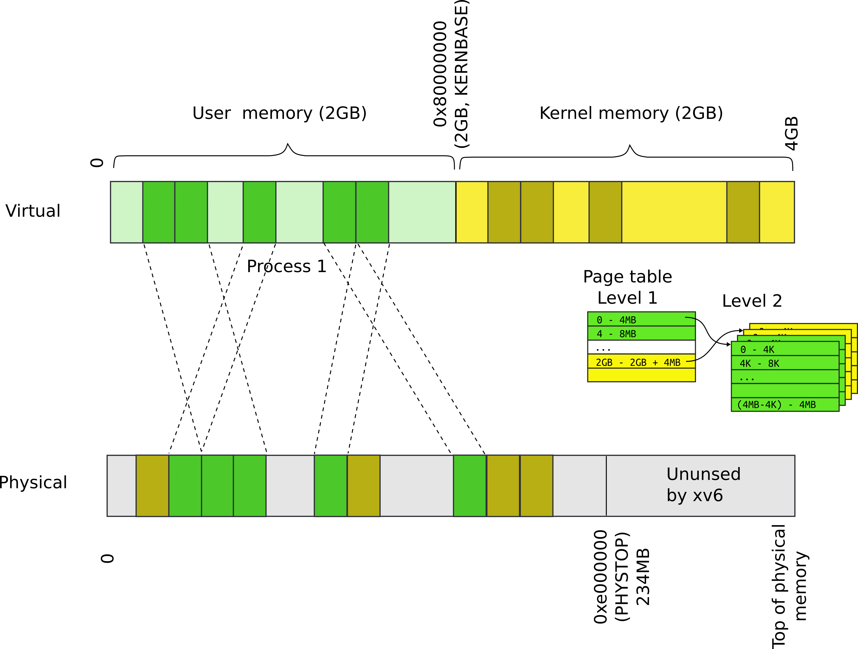
Deallocate address space

Slide 85
Outline: deallocate process address space
Walk the page table
Deallocate all pages mapped by the page table
Deallocate pages that contain Level 2 of the page-table
Deallocate page directory

Slide 86
Deallocate user address space
2015 freevm(pde_t *pgdir)
2016 {
2017 uint i;
2018
2019 if(pgdir == 0)
2020 panic("freevm: no pgdir");
2021 deallocuvm(pgdir, KERNBASE, 0);
2022 for(i = 0; i < NPDENTRIES; i++){
2023 if(pgdir[i] & PTE_P){
2024 char * v = P2V(PTE_ADDR(pgdir[i]));
2025 kfree(v);
2026 }
2027 }
2028 kfree((char*)pgdir);
2029 }

Slide 87
Walk page table and get pte
1987 deallocuvm(pde_t *pgdir, uint oldsz, uint newsz)
1988 {
...
1995 a = PGROUNDUP(newsz);
1996 for(; a < oldsz; a += PGSIZE){
1997 pte = walkpgdir(pgdir, (char*)a, 0);
1998 if(!pte)
1999 a += (NPTENTRIES − 1) * PGSIZE;
2000 else if((*pte & PTE_P) != 0){
2001 pa = PTE_ADDR(*pte);
2002 if(pa == 0)
2003 panic("kfree");
2004 char *v = P2V(pa);
2005 kfree(v);
2006 *pte = 0;
2007 }
2008 }
2009 return newsz;
2010 }

Slide 88
Deallocate a page
1987 deallocuvm(pde_t *pgdir, uint oldsz, uint newsz)
1988 {
...
1995 a = PGROUNDUP(newsz);
1996 for(; a < oldsz; a += PGSIZE){
1997 pte = walkpgdir(pgdir, (char*)a, 0);
1998 if(!pte)
1999 a += (NPTENTRIES − 1) * PGSIZE;
2000 else if((*pte & PTE_P) != 0){
2001 pa = PTE_ADDR(*pte);
2002 if(pa == 0)
2003 panic("kfree");
2004 char *v = P2V(pa);
2005 kfree(v);
2006 *pte = 0;
2007 }
2008 }
2009 return newsz;
2010 }

Slide 89
Deallocate Level 2
2015 freevm(pde_t *pgdir)
2016 {
2017 uint i;
2018
2019 if(pgdir == 0)
2020 panic("freevm: no pgdir");
2021 deallocuvm(pgdir, KERNBASE, 0);
2022 for(i = 0; i < NPDENTRIES; i++){
2023 if(pgdir[i] & PTE_P){
2024 char * v = P2V(PTE_ADDR(pgdir[i]));
2025 kfree(v);
2026 }
2027 }
2028 kfree((char*)pgdir);
2029 }

Slide 90
Deallocate page table directory itself
2015 freevm(pde_t *pgdir)
2016 {
2017 uint i;
2018
2019 if(pgdir == 0)
2020 panic("freevm: no pgdir");
2021 deallocuvm(pgdir, KERNBASE, 0);
2022 for(i = 0; i < NPDENTRIES; i++){
2023 if(pgdir[i] & PTE_P){
2024 char * v = P2V(PTE_ADDR(pgdir[i]));
2025 kfree(v);
2026 }
2027 }
2028 kfree((char*)pgdir);
2029 }

Slide 91
Recap
We know how exec works!
We can create new processes

Slide 92
Creating the first process

Slide 93
1317 main(void)
1318 {
1319 kinit1(end, P2V(4*1024*1024)); // phys page allocator
1320 kvmalloc(); // kernel page table
1321 mpinit(); // detect other processors
...
1323 seginit(); // segment descriptors
...
1330 tvinit(); // trap vectors
...
1338 userinit(); // first user process
1339 mpmain(); // finish this processor’s setup
1340 }
main()

Slide 94
Userinit() – create first process
Allocate process structure
Information about the process

Slide 95
2502 userinit(void)
2503 {
2504 struct proc *p;
2505 extern char _binary_initcode_start[],
_binary_initcode_size[];
...
2509 p = allocproc();
2510 initproc = p;
2511 if((p−>pgdir = setupkvm()) == 0)
2512 panic("userinit: out of memory?");
2513 inituvm(p−>pgdir, _binary_initcode_start,
(int)_binary_initcode_size);
2514 p−>sz = PGSIZE;
2515 memset(p−>tf, 0, sizeof(*p−>tf));
...
2530 }
main()
userinit()

Slide 96
2103 struct proc {
2104 uint sz; // Size of process memory (bytes)
2105 pde_t* pgdir; // Page table
2106 char *kstack; // Bottom of kernel stack for this process
2107 enum procstate state; // Process state
2108 volatile int pid; // Process ID
2109 struct proc *parent; // Parent process
2110 struct trapframe *tf; // Trap frame for current syscall
2111 struct context *context; // swtch() here to run
2112 void *chan; // If non−zero, sleeping on chan
2113 int killed; // If non−zero, have been killed
2114 struct file *ofile[NOFILE]; // Open files
2115 struct inode *cwd; // Current directory
2116 char name[16]; // Process name (debugging)
2117 };

Slide 97
Userinit() – create first process
Allocate process structure
Information about the process
Create a page table
Map only kernel space

Slide 98
2502 userinit(void)
2503 {
2504 struct proc *p;
2505 extern char _binary_initcode_start[],
_binary_initcode_size[];
...
2509 p = allocproc();
2510 initproc = p;
2511 if((p−>pgdir = setupkvm()) == 0)
2512 panic("userinit: out of memory?");
2513 inituvm(p−>pgdir, _binary_initcode_start,
(int)_binary_initcode_size);
2514 p−>sz = PGSIZE;
2515 memset(p−>tf, 0, sizeof(*p−>tf));
...
2530 }
main()
userinit()

Slide 99
Remember: each process maps kernel in its page table

Slide 100
Userinit() – create first process
Allocate process structure
Information about the process
Create a page table
Map only kernel space
Allocate a page for the user init code
Map this page

Slide 101
2502 userinit(void)
2503 {
2504 struct proc *p;
2505 extern char _binary_initcode_start[],
_binary_initcode_size[];
...
2509 p = allocproc();
2510 initproc = p;
2511 if((p−>pgdir = setupkvm()) == 0)
2512 panic("userinit: out of memory?");
2513 inituvm(p−>pgdir, _binary_initcode_start,
(int)_binary_initcode_size);
2514 p−>sz = PGSIZE;
2515 memset(p−>tf, 0, sizeof(*p−>tf));
...
2530 }
main()
userinit()

Slide 102
1903 inituvm(pde_t *pgdir, char *init, uint sz)
1904 {
1905 char *mem;
1906
1907 if(sz >= PGSIZE)
1908 panic("inituvm: more than a page");
1909 mem = kalloc();
1910 memset(mem, 0, PGSIZE);
1911 mappages(pgdir, 0, PGSIZE, V2P(mem),
PTE_W|PTE_U);
1912 memmove(mem, init, sz);
1913 }
main()
userinit()
inituvm()

Slide 103
1903 inituvm(pde_t *pgdir, char *init, uint sz)
1904 {
1905 char *mem;
1906
1907 if(sz >= PGSIZE)
1908 panic("inituvm: more than a page");
1909 mem = kalloc();
1910 memset(mem, 0, PGSIZE);
1911 mappages(pgdir, 0, PGSIZE, V2P(mem),
PTE_W|PTE_U);
1912 memmove(mem, init, sz);
1913 }
main()
userinit()
inituvm()

Slide 104
2502 userinit(void)
2503 {
2504 struct proc *p;
2505 extern char _binary_initcode_start[],
_binary_initcode_size[];
...
2509 p = allocproc();
2510 initproc = p;
2511 if((p−>pgdir = setupkvm()) == 0)
2512 panic("userinit: out of memory?");
2513 inituvm(p−>pgdir, _binary_initcode_start,
(int)_binary_initcode_size);
2514 p−>sz = PGSIZE;
2515 memset(p−>tf, 0, sizeof(*p−>tf));
...
2530 }
main()
userinit()

Slide 105
1903 inituvm(pde_t *pgdir, char *init, uint sz)
1904 {
1905 char *mem;
1906
1907 if(sz >= PGSIZE)
1908 panic("inituvm: more than a page");
1909 mem = kalloc();
1910 memset(mem, 0, PGSIZE);
1911 mappages(pgdir, 0, PGSIZE, V2P(mem),
PTE_W|PTE_U);
1912 memmove(mem, init, sz);
1913 }
main()
userinit()
inituvm()

Slide 106
8409 start:
8410 pushl $argv
8411 pushl $init
8412 pushl $0 // where caller pc would be
8413 movl $SYS_exec, %eax
8414 int $T_SYSCALL
8415
...
8422 # char init[] = "/init\0";
8423 init:
8424 .string "/init\0"
8425
8426 # char *argv[] = { init, 0 };
8427 .p2align 2
8428 argv:
8429 .long init
8430 .long 0
initcode.S: call exec(“/init”, argv);

Slide 107
userinit() – create first process
Allocate process structure
Information about the process
Create a page table
Map only kernel space
Allocate a page for the user init code
Map this page
Configure trap frame for “iret”

Slide 108
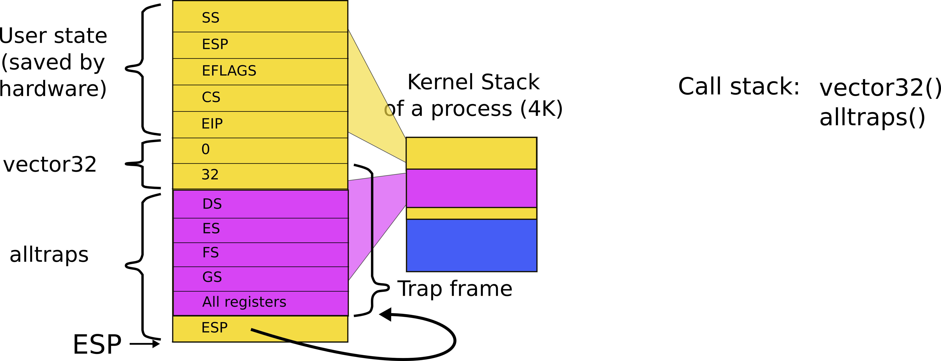
We need to configure the following kernel
The stack of a process after interrupt/syscall

Slide 109
2103 struct proc {
2104 uint sz; // Size of process memory (bytes)
2105 pde_t* pgdir; // Page table
2106 char *kstack; // Bottom of kernel stack for this process
2107 enum procstate state; // Process state
2108 volatile int pid; // Process ID
2109 struct proc *parent; // Parent process
2110 struct trapframe *tf; // Trap frame
2111 struct context *context; // swtch() here to run
2112 void *chan; // If non−zero, sleeping on chan
2113 int killed; // If non−zero, have been killed
2114 struct file *ofile[NOFILE]; // Open files
2115 struct inode *cwd; // Current directory
2116 char name[16]; // Process name (debugging)
2117 };

Slide 110
2456 allocproc(void)
2457 {
...
2470 // Allocate kernel stack.
2471 if((p−>kstack = kalloc()) == 0){
2472 p−>state = UNUSED;
2473 return 0;
2474 }
2475 sp = p−>kstack + KSTACKSIZE;
2476
2477 // Leave room for trap frame.
2478 sp −= sizeof *p−>tf;
2479 p−>tf = (struct trapframe*)sp;
2480
...
2492 }
Trap frame is on the
kernel stack of the process

Slide 111
2502 userinit(void)
2503 {
...
2513 inituvm(p−>pgdir, _binary_initcode_start,
(int)_binary_initcode_size);
2514 p−>sz = PGSIZE;
2515 memset(p−>tf, 0, sizeof(*p−>tf));
2516 p−>tf−>cs = (SEG_UCODE << 3) | DPL_USER;
2517 p−>tf−>ds = (SEG_UDATA << 3) | DPL_USER;
2518 p−>tf−>es = p−>tf−>ds;
2519 p−>tf−>ss = p−>tf−>ds;
2520 p−>tf−>eflags = FL_IF;
2521 p−>tf−>esp = PGSIZE;
2522 p−>tf−>eip = 0; // beginning of initcode.S
...
2530 }

Slide 112
Kernel stack after interrupt/syscall

Slide 113
2502 userinit(void)
2503 {
...
2515 memset(p−>tf, 0, sizeof(*p−>tf));
2516 p−>tf−>cs = (SEG_UCODE << 3) | DPL_USER;
2517 p−>tf−>ds = (SEG_UDATA << 3) | DPL_USER;
2518 p−>tf−>es = p−>tf−>ds;
2519 p−>tf−>ss = p−>tf−>ds;
2520 p−>tf−>eflags = FL_IF;
2521 p−>tf−>esp = PGSIZE;
2522 p−>tf−>eip = 0; // beginning of initcode.S
2523
2524 safestrcpy(p−>name, "initcode", sizeof(p−>name));
2525 p−>cwd = namei("/");
2526
2527 p−>state = RUNNABLE;
...
2530 }

Slide 114
Wait, we mapped process memory, created trap frame, but it doesn't really run...

Slide 115
8510 main(void)
8511 {
...
8521 for(;;){
8522 printf(1, "init: starting sh\n");
8523 pid = fork();
8524 if(pid < 0){
8525 printf(1, "init: fork failed\n");
8526 exit();
8527 }
8528 if(pid == 0){
8529 exec("sh", argv);
8530 printf(1, "init: exec sh failed\n");
8531 exit();
8532 }
8533 while((wpid=wait()) >= 0 && wpid != pid)
8534 printf(1, "zombie!\n");
8535 }
8536 }
First process exec(“init”)
/init starts /sh
fork() and exec(“sh”)

Slide 116
Summary
We've finally learned how the first process came to life
Also we know:
How OS boots and initializes itself
How each process is constructed (exec())
How OS switches between processes

Slide 117
Thank you!

